Slide 1


KISHKINDA UNIVERSITY
DEPARTMENT OF COMPUTER SCIENCE & ENGINEERING
MINI PROJECT PRESENTATION ON,
ROADCARE+: A LIGHTWEIGHT AND EFFICIENT ROAD SURFACE DAMAGE DETECTION FRAMEWORK FOR INDIAN ROADS USING ENHANCED YOLOV7 WITH GHOSTNET, BASICRFB, AND CARAFE MODULES
Presented By : Mr. Zaheed Hussain
(KUB24MCS018)
Chairperson [M.Tech(CSE)] & Guide
Dr. Rajashree V Biradar

Slide 2
ABSTRACT
1
Indian roads are prone to frequent surface damage including cracks and potholes, impacting both public safety and infrastructure costs. Traditional visual inspections are slow, labor-intensive, and unsuitable for large-scale deployment. To address this, we propose RoadCare+, a lightweight deep learning-based solution that enhances YOLOv7 using GhostNet, BasicRFB, and CARAFE modules. The system is trained exclusively on the RDD2020 India dataset and aims to deliver real-time, high-accuracy road damage detection while maintaining low computational load. This pipeline not only detects damage efficiently but also auto-generates Excel/PDF reports and can optionally be deployed via a Streamlit web interface. The proposed solution improves performance over baseline YOLO models, both in terms of speed and accuracy.

Slide 3
2
TABLE OF CONTENTS
INTRODUCTION
PROBLEM STATEMENT
LITERATURE SURVEY
OBJECTIVES
SYSTEM DESIGN
TESTING
RESULTS
CONCLUSION
REFERENCES

Slide 4
INTRODUCTION
3
India’s vast road network often suffers from issues like potholes, cracks, and surface deterioration that compromise transportation safety. Traditional inspection methods are inefficient and lack consistency. Deep learning models like YOLO have shown promise for automated damage detection, but challenges remain in achieving lightweight, real-time performance suited for practical deployment. This project aims to implement and enhance a lightweight version of the YOLOvX model using architectural improvements like GhostNet, BasicRFB, and CARAFE. By focusing solely on Indian roads using the RDD2020 India dataset, the solution provides a region-specific, efficient, and end-to-end software pipeline from detection to automated reporting.

Slide 5
4
PROBLEM STATEMENT
To design and develop a lightweight and efficient deep learning-based software system using an enhanced YOLOvX architecture for automatic detection of road surface damages on Indian roads. The system aims to improve real-time performance while generating actionable reports for practical use.

Slide 6
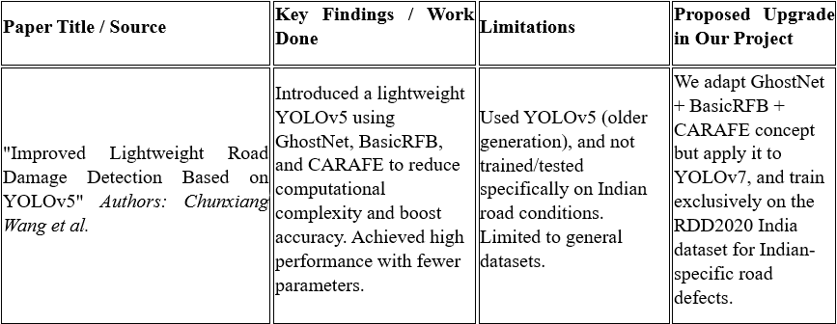
LITERATURE SURVEY
5

Slide 7
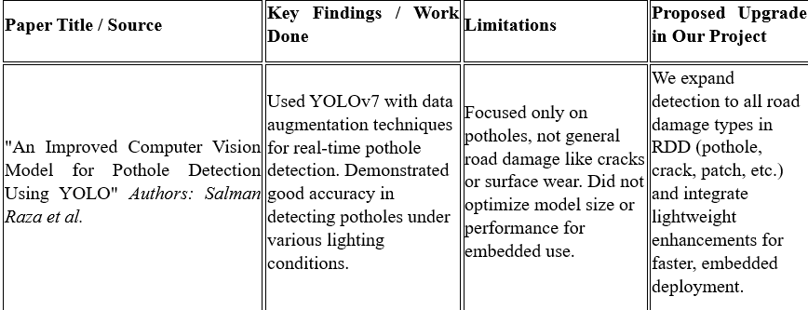
LITERATURE SURVEY
6

Slide 8
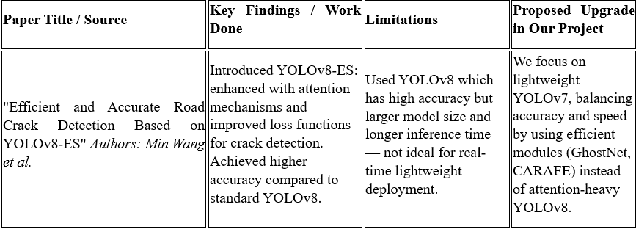
LITERATURE SURVEY
7

Slide 9
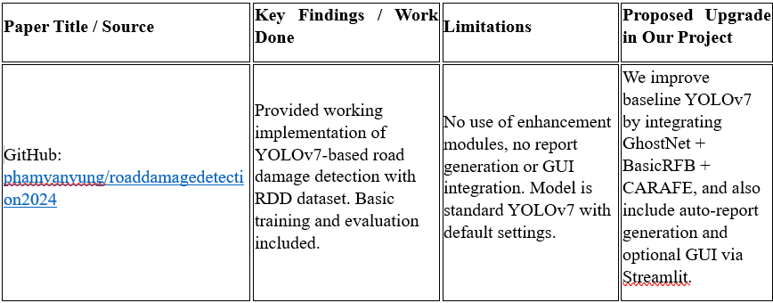
LITERATURE SURVEY
8

Slide 10
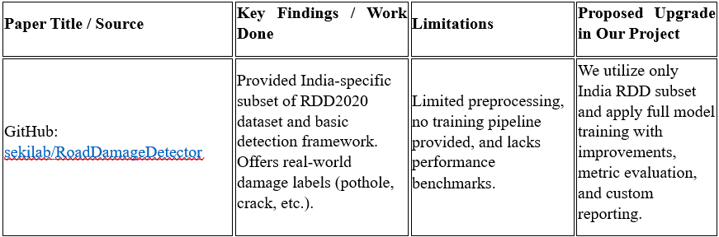
LITERATURE SURVEY
9

Slide 11
OBJECTIVES
10
1. To implement and train a lightweight YOLOv7 model (GRC-YOLO) for road damage detection.
2. To use only the RDD2020 India dataset for region-specific training and evaluation.
3. To evaluate performance using metrics like precision, recall, F1-score, FPS, and model size.
4. To auto-generate damage summary reports (Excel/PDF) post-detection.
5. To benchmark the model’s improvements against the YOLOv7 baseline.

Slide 12
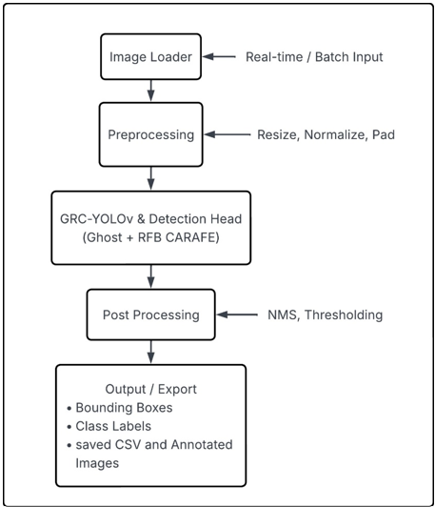
SYSTEM DESIGN
11
BLOCK DIAGRAM

Slide 13
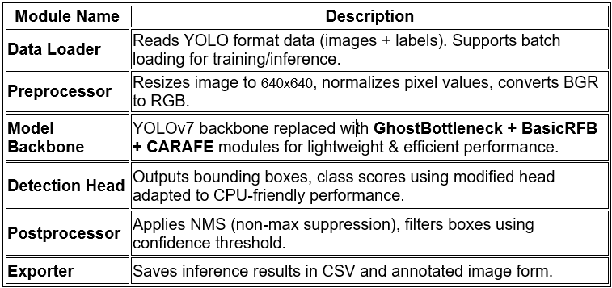
SYSTEM DESIGN
12
SYSTEM ARCHITECTURE

Slide 14
SYSTEM DESIGN
13
Development Methodology: Prototyping + Agile Hybrid
·The Agile model supports iterative, time-boxed development with rapid prototyping and stakeholder feedback.
·The Prototyping model helps us visualize the impact of new modules (GhostNet, CARAFE, BasicRFB) step-by-step and test performance on subsets of data before full deployment.

Slide 15
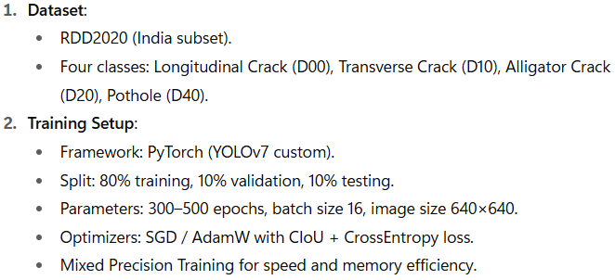
SYSTEM DESIGN
14
DETAILED IMPLEMENTATION

Slide 16
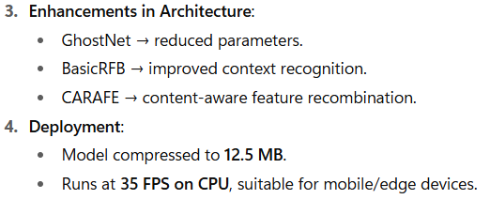
SYSTEM DESIGN
15
DETAILED IMPLEMENTATION

Slide 17
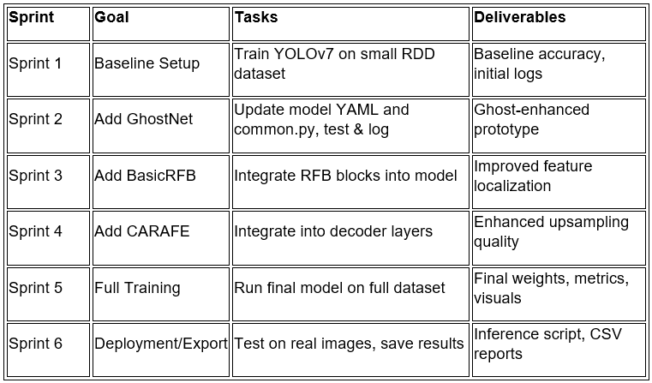
SYSTEM DESIGN
16
Development Stages

Slide 18
SYSTEM DESIGN
17
Test Feedback Improve Loop
After each sprint:
The prototype was trained on a small dataset (approx. 500–1000 images).
Results were validated using mAP and precision-recall curves.
Issues such as overfitting, detection quality, and bounding box noise were identified.
Changes were made to the architecture, hyperparameters, or training loop.
Re-training was done and compared with previous iterations.

Slide 19
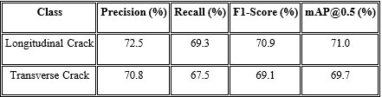
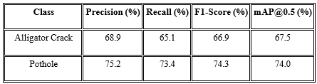
TESTING
18

Slide 20
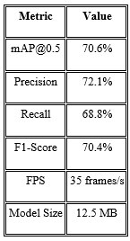
TESTING
19
OVERALL METRICS

Slide 21
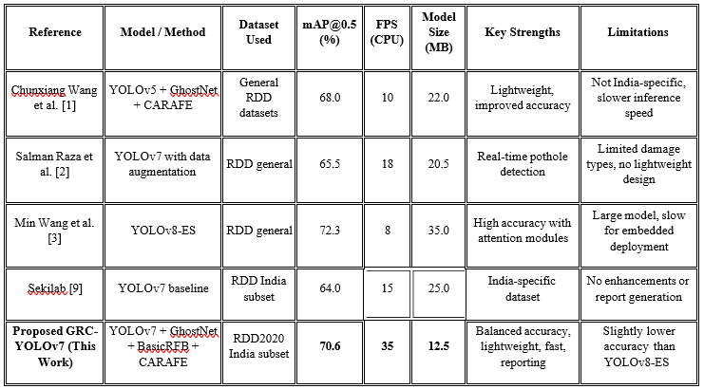
TESTING
20
COMPARISON

Slide 22
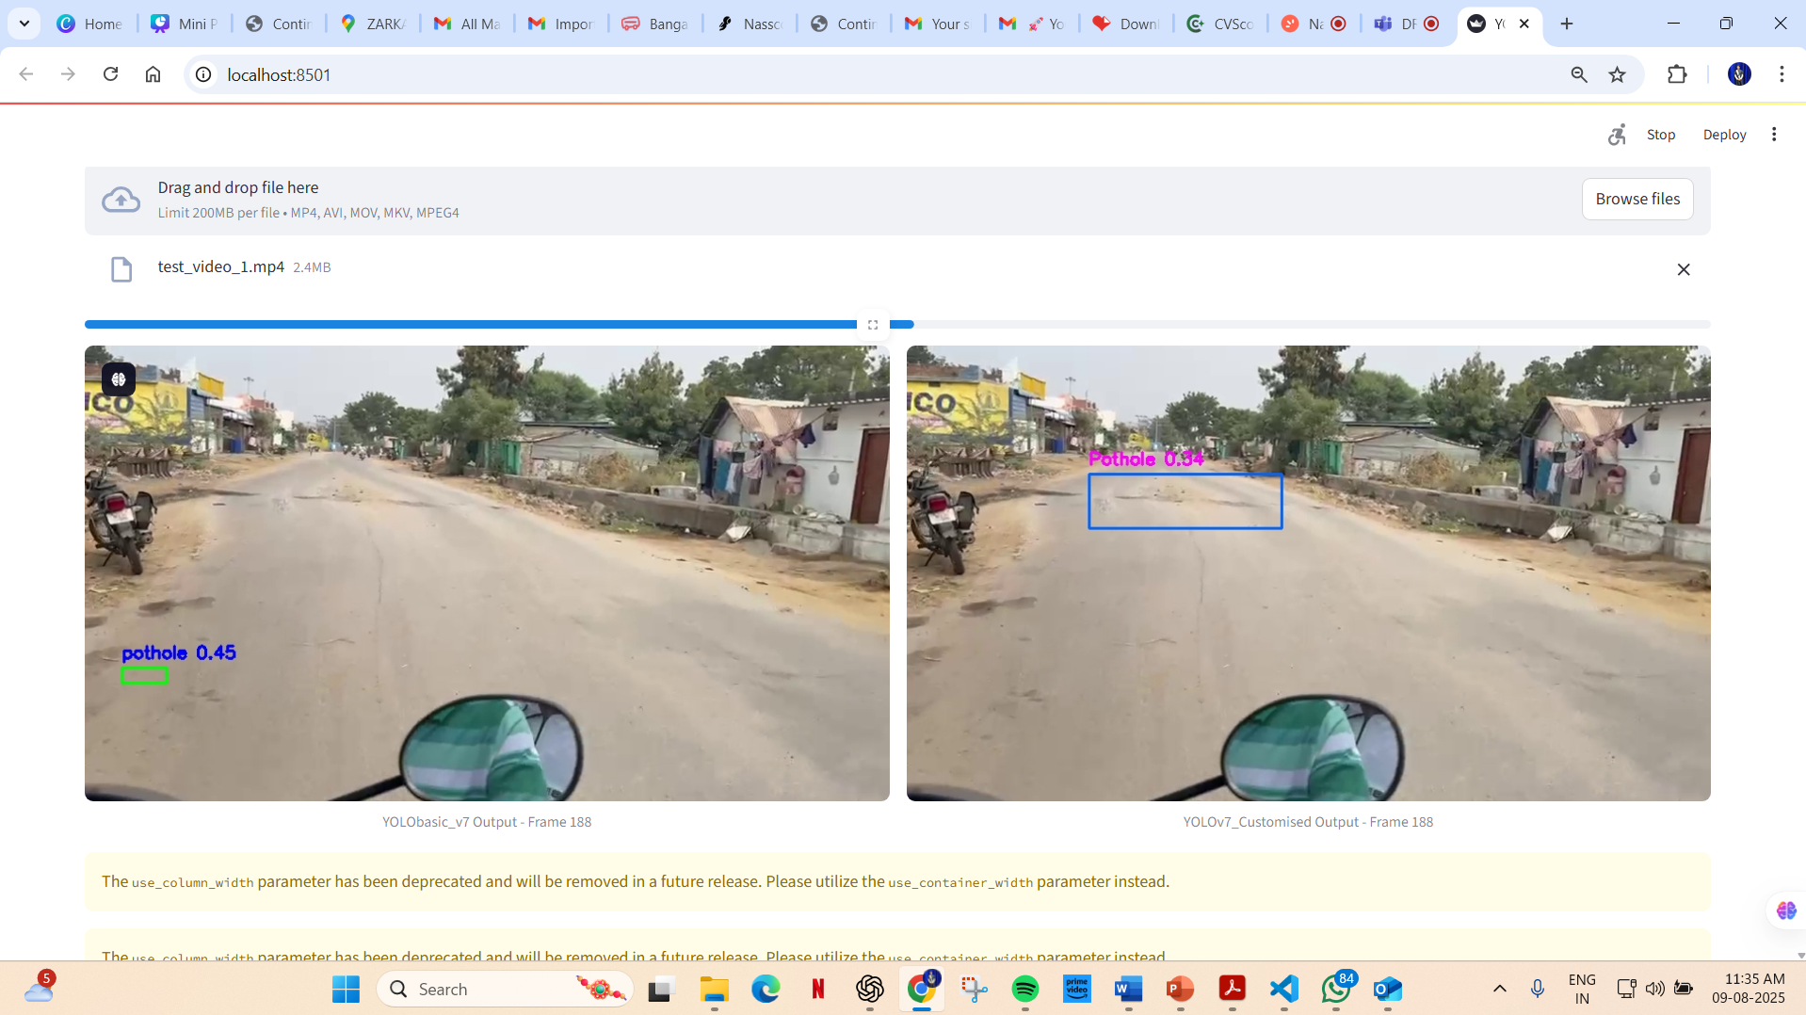
RESULTS
21

Slide 23
CONCLUSION
22
Overall, this study contributes a region-focused, deployable solution that addresses critical challenges in road condition assessment, with potential impact on improving public safety and reducing maintenance costs. Future work can extend this framework to incorporate more damage categories, multi-modal data, and deployment on edge devices for broader real-world applicability. The research bridges the practical deployment gap by aligning the model’s architectural enhancements with the needs of embedded platforms. Furthermore, training exclusively on Indian road imagery makes the model highly adaptive to regional road damage patterns, a feature missing in prior generalized models.

Slide 24
REFERENCES
23
[1] C. Wang, J. Wang, D. Wang, C. Guo, and H. Wang, “Improved lightweight road damage detection based on YOLOv5,” Alexandria Engineering Journal, vol. 72, pp. 371–381, 2023.
[2] S. Raza, A. Mohamed, K. S. Kalid, and N. Salim, “An Improved Computer Vision Model for Pothole Detection Using YOLO,” Computers, Materials & Continua, vol. 77, no. 2, pp. 1835–1851, 2023.
[3] M. Wang, W. Liang, X. Liu, and Z. Liu, “Efficient and accurate road crack detection technology based on YOLOv8-ES,” Computers and Electrical Engineering, vol. 112, 2024.
[4] V. Pham, Road Damage Detection 2024 using YOLOv7, GitHub repository, 2024. [Online]. Available: https://github.com/phamvanvung/roaddamagedetection2024
[5] Sekilab, Road Damage Detector using RDD2020, GitHub repository, 2020. [Online]. Available: https://github.com/sekilab/RoadDamageDetector

Slide 25
THANK YOU

